Slide 1
Finding the Subnet, Broadcast and Useable Host Ranges
Lecture 9
Broadcasting, Distance Vector Routing

Slide 2
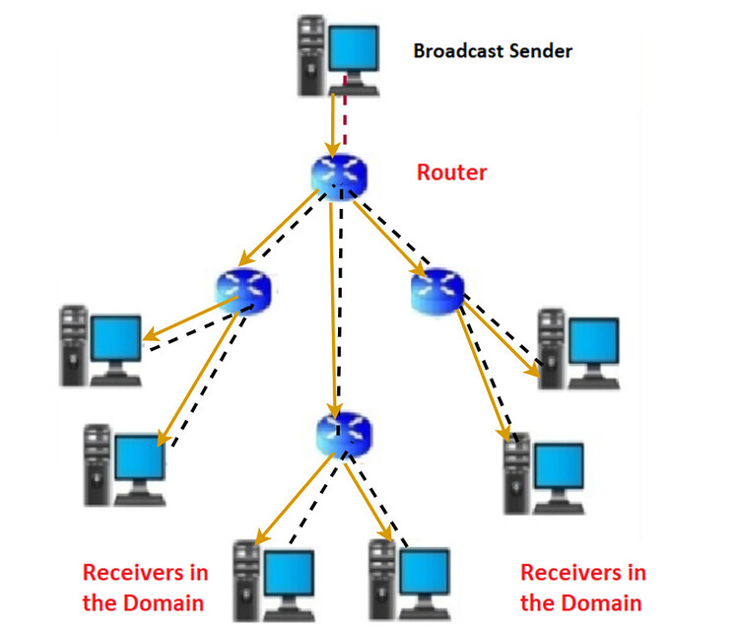
Difference between flooding and broadcasting
Sending a packet to all hosts simultaneously is broadcasting. But flooding does not send packets to all hosts simultaneously. The packets would ultimately reach all nodes in the network due to flooding.
Figure: Broadcasting

Slide 3
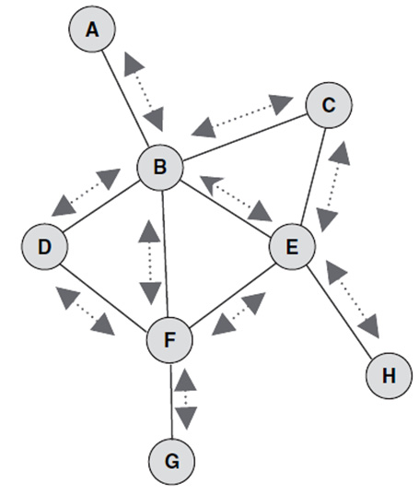
Difference between flooding and broadcasting
Flooding may send the same packet along the same link multiple times, but broadcasting sends a packet along a link at most once. Several copies of the same packet may reach nodes in flooding, while broadcasting does not cause that problem. Unlike flooding, broadcasting is done by specifying a special broadcast address on packets.

Slide 4
Distance Vector Routing Protocol
Modern computer networks generally use dynamic routing algorithm.
Two dynamic algorithms in particular, distance vector routing and link state routing, are the most popular.
Distance vector routing algorithms operate by having maintain a table (i.e., a vector) giving the best known distance to each destination and which line to use to go there.
The tables are updated by exchanging information with the neighbors.

Slide 5
Cont.
The distance vector routing is sometimes called by other names, including the distributed Bellman-Ford routing algorithm and the Ford-Fulkerson algorithm, after the researchers who developed it.
It was the original ARPANET routing algorithm and was also used in the internet under the name RIP.

Slide 6
The Meaning of Distance Vector
A router using distance vector routing protocols knows TWO things:
Distance to final destination(Distance is commonly defined as the number of steps, or hosts, a message must go through to get to its destination.)
Vector, or direction, traffic should be directed.(The vector describes the trajectory of the message over a given set of network nodes.)

Slide 7
Cont.
Each node computes its forwarding table in a distributed settings:
Nodes know only the cost to their neighbours; not the topology.
Nodes can talk only to their neighbours using messages.
All nodes run the same algorithm concurrently.
Nodes and links may fail. Messages may be lost.

Slide 8
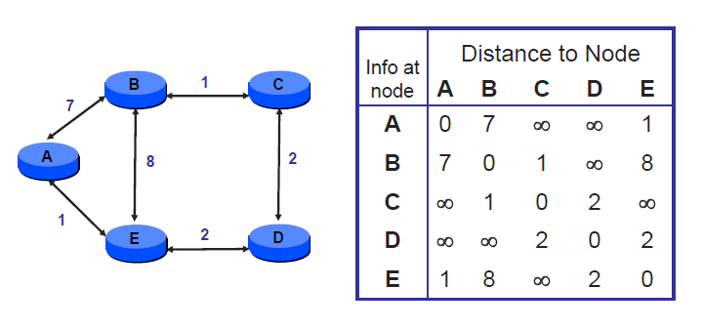
Distance Vector Example: Initial State

Slide 9
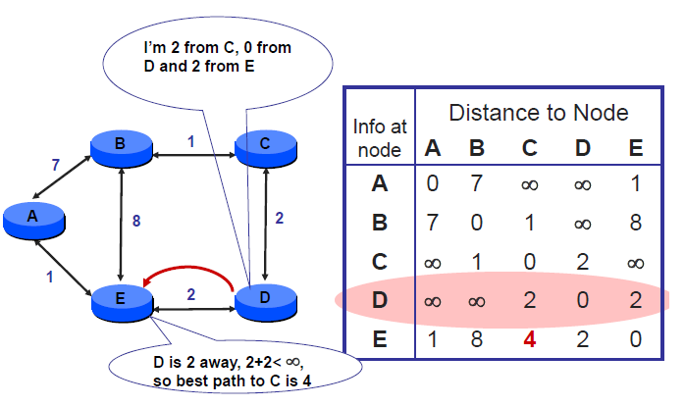
D sends vector to E

Slide 10
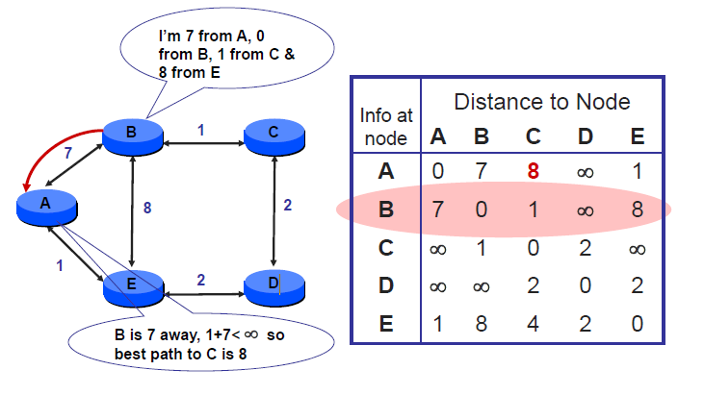
B sends vector to A

Slide 11
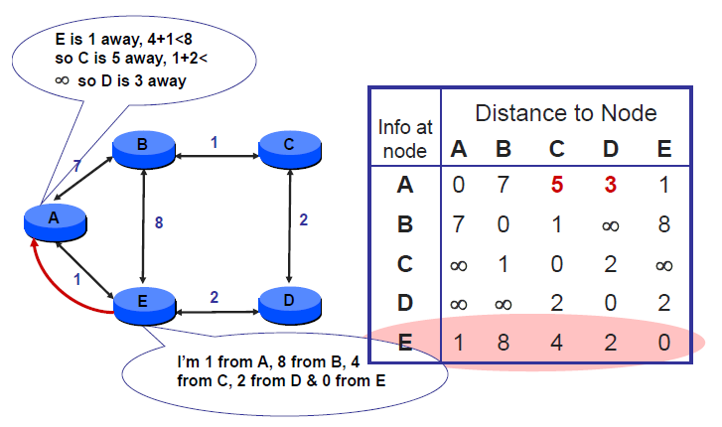
E sends vector to A

Slide 12
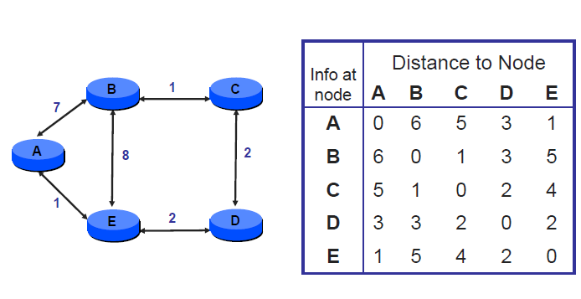
...until Convergence

Slide 13
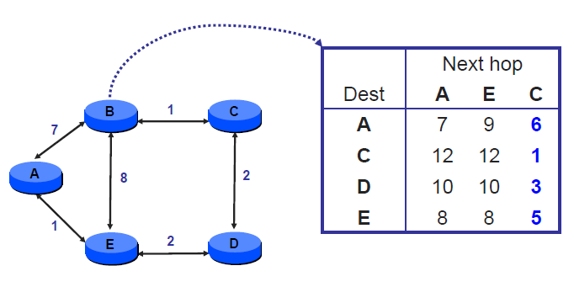
Node B’s distance vectors

Slide 14
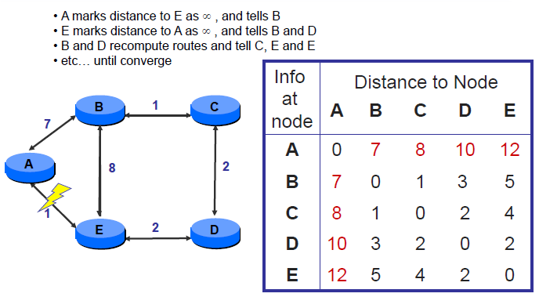
Handling Link Failure

Slide 15
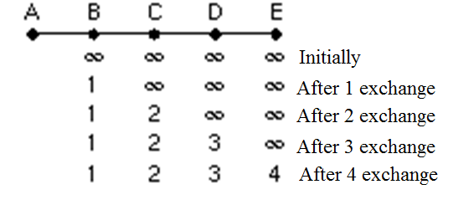
The Count-to-Infinity Problem
DV routing works in theory but has a serious drawback in practice: although it converges to the correct answer, it may do so slowly.
In particular, it reacts rapidly to good news, but leisurely to bad news.
To see how fast good news propagates, consider the five node linear subnet, where the delay metric is number of hops

Slide 16
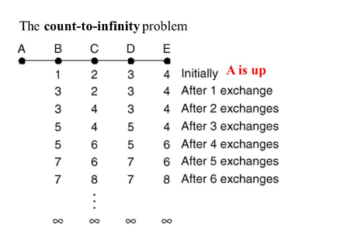
Cont.
Initially all the lines and routers are initially up.
Routers B, C, D and E have distances to A of 1,2,3 and 4 respectively.
Suddenly the line between A and B is cut.

Slide 17
Cont.
At the first packet exchange, B does not hear anything from A. Fortunately C says “Do not worry. I have a path to A of length 2.” Little does B know that C’s path runs through B itself. For all B knows that C might have another outgoing line with independent path to A of length 2. As a result, B now thinks it can reach A via C, with path length of 3. D and E do not update their entries for A on the first exchange.

Slide 18
Cont.
On the second exchange, C notices that each of its neighbours claims to have a path to A of length 3. It picks one of them at random and makes its new distance to A 4, as shown in third row.

Slide 19
Cont.
On the third exchange, D notices that each of its neighbors claims to have a path to A of length 4. It picks one of them at random and makes its new distance to A 5, as shown in third row.
Also B notices that it can reach A via C and it makes its new distance to A 5.

Slide 20
Cont.
On the fourth exchange, E can reach A via D and make its distance to A as 6. Also C notices that each of its neighbors claims to have a path to A of length 5. It picks one of them at random and makes its new distance to A 6, as shown in fourth row. Subsequently exchanges produce the history shown in the rest of the figure. Gradually, all the routers work their up to infinity.

Slide 21
RIP (Routing Information Protocol)
DV protocol with hop count as metric
Infinity is 16 hops
Includes split horizon
Router send vectors every 30 sec.
Runs on top of UDP
RIPv1 specified in RFC1058(1988)
RIPv1 exploits broadcasting.
RIP1 supports class full routing protocol (FLSM)
RIP2 supports class less routing protocol. (VLSM)

Slide 22
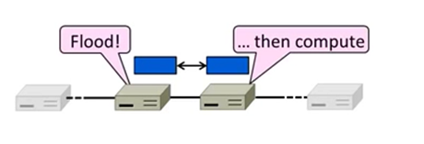
Link State Routing
Widely used in practice
  Used in internet/ARPANET from 1979
  Modern networks use OSPF(Open Shortest Path First) and 1S-IS (Intermediate system to Intermediate system)

Slide 23
Link-State Algorithm
Proceeds in two phases:
Nodes flood topology in the form of link state packets
  Each node learns full topology
Each node computes its own forwarding table
  By running Dijkstra (or equivalent)

Slide 24
How Link State Routing Works-Example
Link state - router knows entire network topology and computes shortest pathRouting.
Each node send it’s neighbour information known as Link State Advertisement.
LS advertisement sent of periodic basis.
Once node has complete view of network then it populate it’s routing table by using Dijkastra algorithm for shortest path.

Slide 25
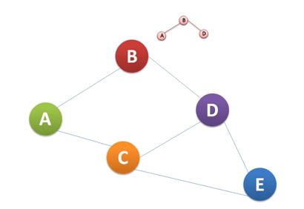
Cont.
Node B’s LS advertisement

Slide 26
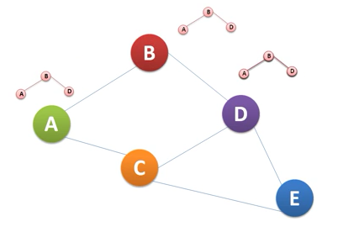
Cont.

Slide 27
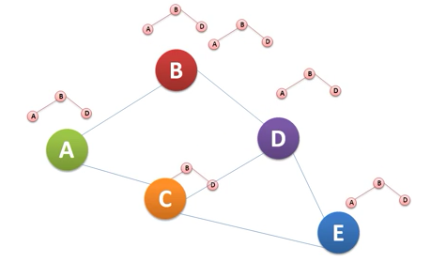
Cont.
Node B would find out that this message has been sent by B.

Slide 28
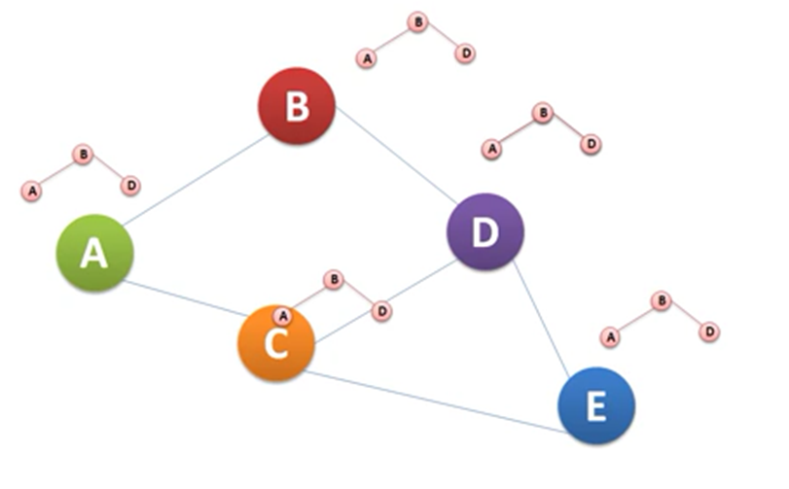
Cont.

Slide 29
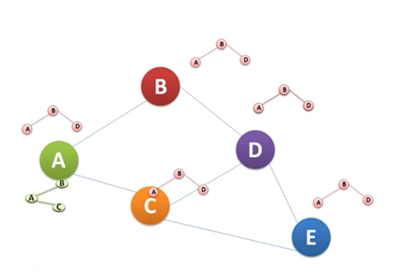
Cont.
Node A’s LS advertisement

Slide 30
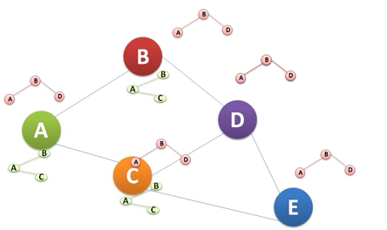
Cont.

Slide 31
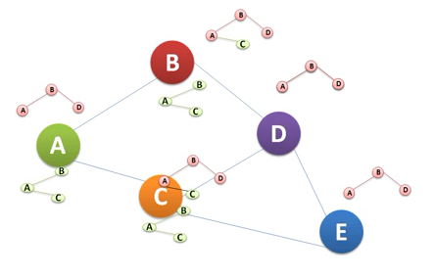
Cont.
On Receiving A’s LS node B and C will update their topology information and also forward these packets.

Slide 32
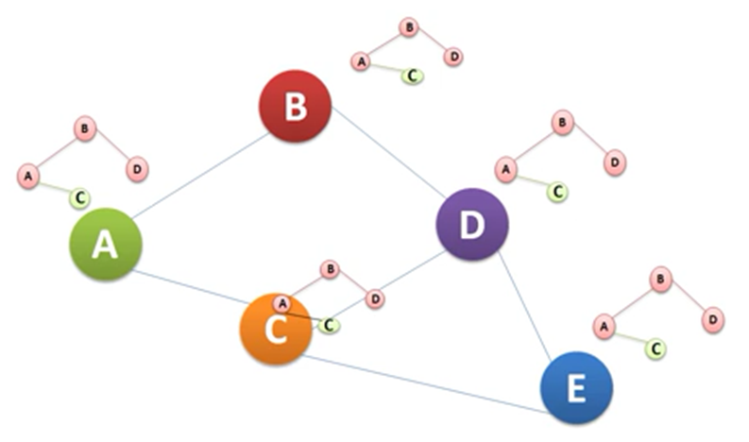
Cont.

Slide 33
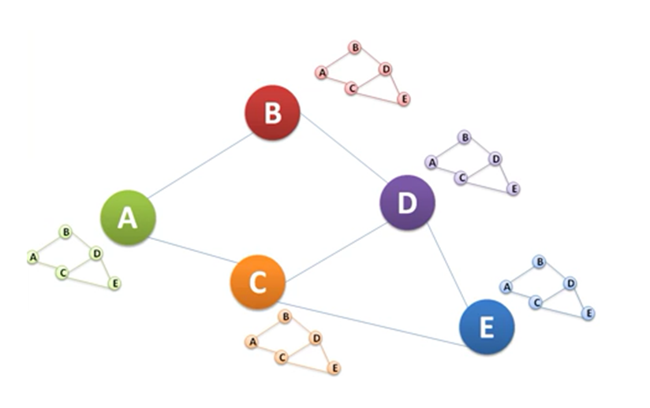
Cont.
After exchange of LS advertisement from, every node will be having complete view of network.
LS advertisement sent of periodic basis.
Once node has complete view of network then it populate it’s routing table by using Dijkastra alogorithm for shortest path.

Slide 34
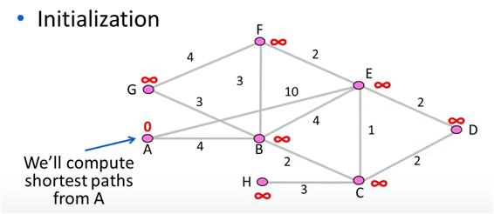
Review
How to compute shortest paths given the network topology
  -With Dijkstra’s algorithm

Slide 35
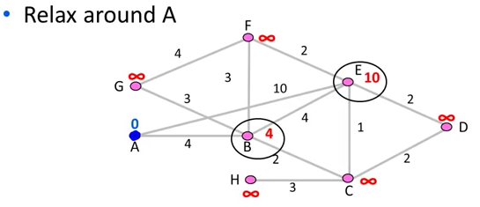
Cont.
Both E and B nodes have been relaxed.

Slide 36
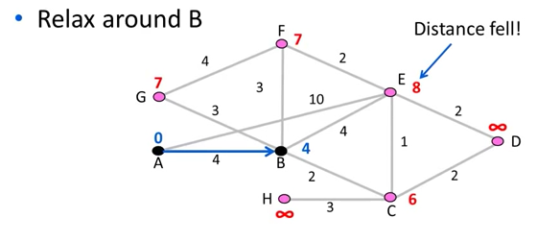
Cont.

Slide 37
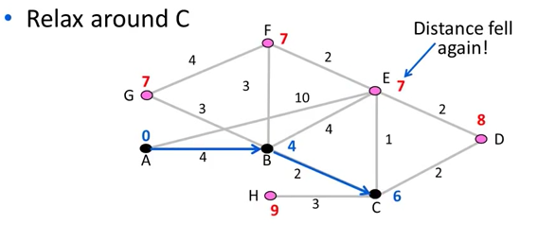
Cont.

Slide 38
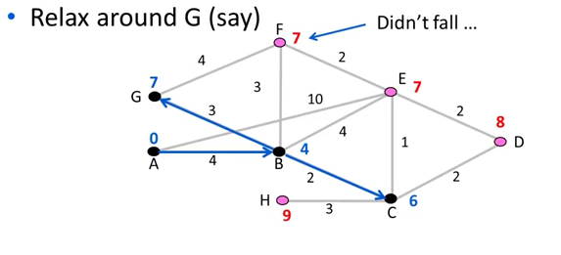
Cont.

Slide 39
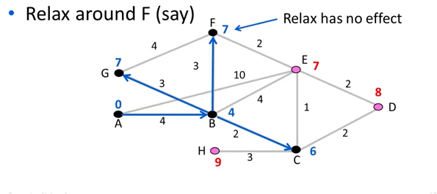
Cont.

Slide 40
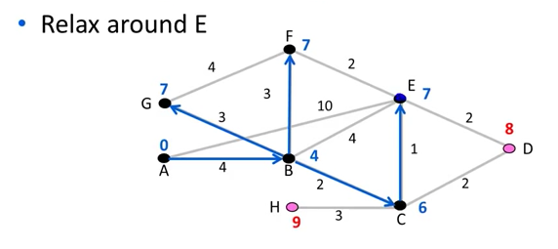
Cont.

Slide 41
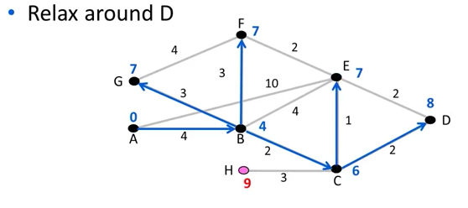
Cont.

Slide 42
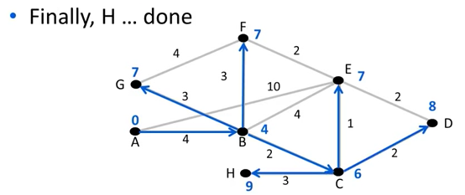
Cont.

Slide 43
Hierarchical Routing
As networks grow in size, the router routing tables grow proportionally. Not only is router memory consumed by ever-increasing tables, but more CPU time is needed to scan them and more bandwidth is needed to send status reports about them. At a certain point, the network may grow to the point where it is no longer feasible for every router to have an entry for every other router, so the routing will have to be done hierarchically, as it is in the telephone network.

Slide 44
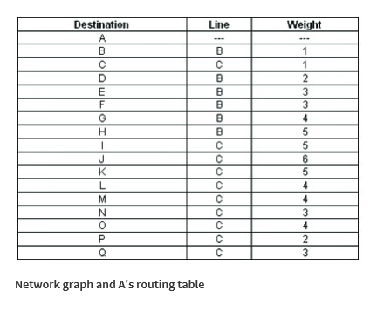
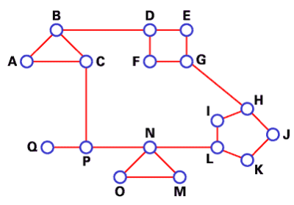
Example
Figure below gives a quantitative example of routing in a two-level hierarchy with five regions. We use DV algorithm to find best routes between nodes. The full routing table for router A has 17 entries, as shown in The.

Slide 45
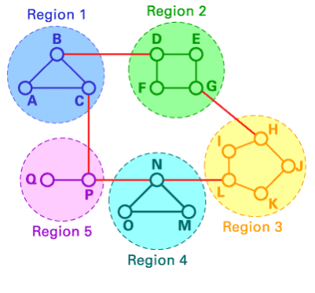
Cont.
When routing is done hierarchically, as in Fig. (c), there are entries for all the local routers, as before, but all other regions are condensed into a single router, so all traffic for region 2 goes via the B-D line, but the rest of the remote traffic goes via the C-P line. Hierarchical routing has reduced the table from 17 to 7 entries. As the ratio of the number of regions to the number of routers per region grows, the savings in table space increase.
Destination | Line | Hop
A | - | -
B | B | 1
C | C | 1
Region 2 | B | 2
Region 3 | C | 4
Region 4 | C | 3
Region 5 | C | 2

Slide 46
Cont.
Unfortunately, these gains in space are not free. There is a penalty to be paid: increased path length. For example, the best route from A to H is via region 2, but with hierarchical routing all traffic to region 3 goes via region 5, because that is better for most destinations in region 3.
Destination | Line | Hop
A | - | -
B | B | 1
C | C | 1
Region 2 | B | 2
Region 3 | C | 4
Region 4 | C | 3
Region 5 | C | 2

Slide 47
Cont.
When a single network becomes very large, an interesting question is ‘‘how many levels should the hierarchy have?’’
For example, consider a network with 720 routers. If there is no hierarchy, each router needs 720 routing table entries.
If the network is partitioned into 24 regions of 30 routers each, each router needs 30 local entries plus 23 remote entries for a total of 53 entries.
If a three-level hierarchy is chosen, with 8 clusters each containing 9 regions of 10 routers, each router needs 10 entries for local routers, 8 entries for routing to other regions within its own cluster, and 7 entries for distant clusters, for a total of 25 entries.

